Slide 1
Managing Imported Fill
Prepared and Presented by Tom Farrell, CHMM, Chief, NJDEP- Bureau of Solid Waste Compliance and Enforcement
October 10, 2018

Slide 2
DISCLAIMER
Information presented in this presentation
contains a mixture of excerpts from current
regulations, policies and opinions. Any
opinions expressed herein are not the official
position of the New Jersey Department of Environmental Protection. Any data researched and
presented has not been vetted and should not be
considered NJDEP’s position on any matters.

Slide 3
September 2017 Updates to Definitions in N.J.A.C. 7:26- 1.4
Definition of clean fill is removed. No longer is product from a Class B Recycling facility automatically considered as clean fill.
“Contaminated soil” is now defined and tied to the Direct Contact Soil Remediation Standards at N.J.A.C. 7:26D.

Slide 4
September 2017 Updates to Definitions in N.J.A.C. 7:26- 1.6
Amended the definition of solid waste to include: “…processed or unprocessed mixed construction and demolition debris..”
Amended the description of materials excluded from the definition of solid waste as being compliant with the Direct Contact Soil Remediation Standards at N.J.A.C. 7:26D.

Slide 5
Some Perspective
Concentrations of Benzo(a)Pyrene in Common Foods:
Source Food Mg of B(a)P Per Serving
Charcoal Broiled Meats 0.0020
Kale or Spinach 0.0003
Total Daily Intake B(a)P 0.0023 Mg
The B(a)P Direct Contact Non-Residential Soil Remediation Standard of 2.0 mg/Kg is based on an ingestion rate of 100 mg/day (dust inhalation, dermal
contact, incidental ingestion) which results in an adult ingesting about 87 times more B(a)P than is their diet.

Slide 6
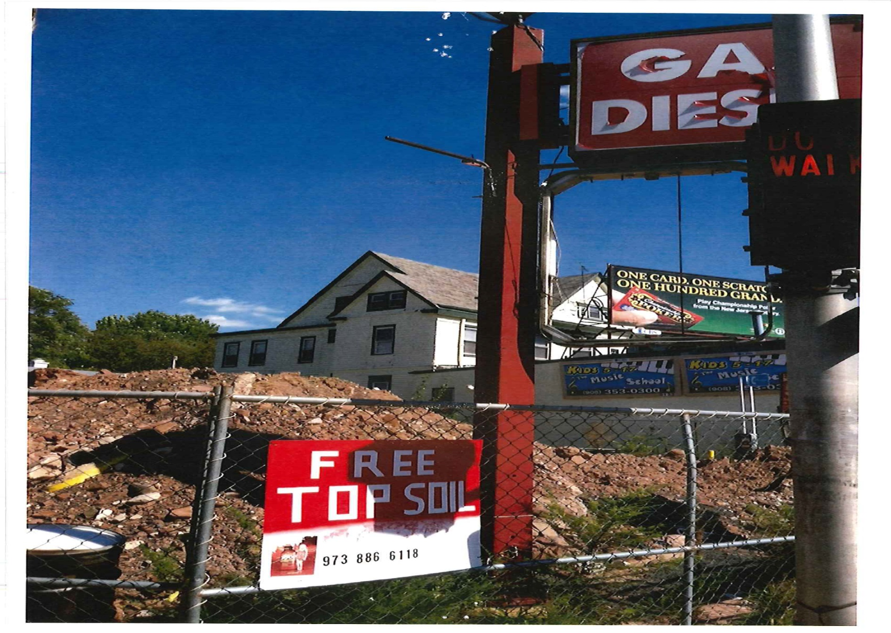

Slide 7
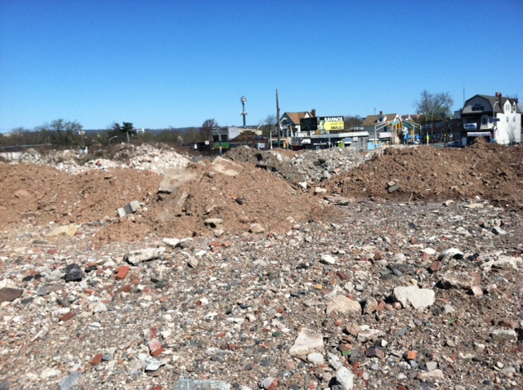

Slide 8
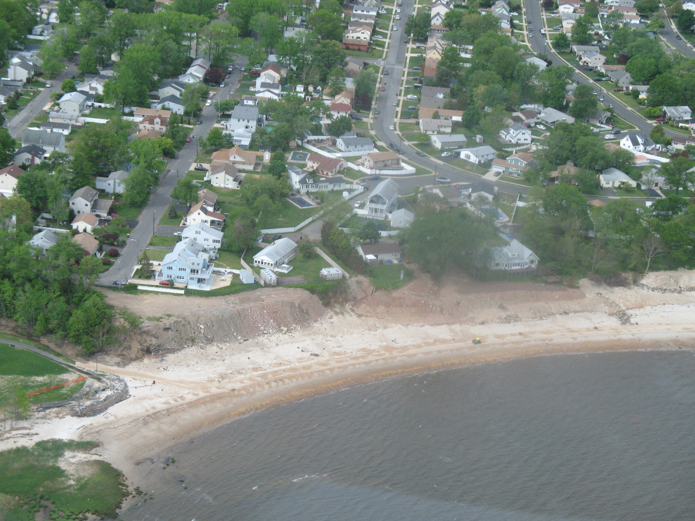
Example 1 of Illegal Fill

Slide 9
Case History
Soil Broker had written contract with developer of a combined residential/commercial use property to provide 20,000 cubic yards of “clean fill that met all NJ standards” and delivered same to construction site.
Construction nearly completed when NJDEP discovered that Broker’s documentation of soil quality included only 1 sample and it exceeded the RDCSRS by 0.05 ppm for B(a)P prompting Order.

Slide 10
Case History (continued)
Developer hired consultant to fully characterize the soils from the Broker and found that over 90% of the samples failed.
Developer hired LSRP pursuant to the ARRCS process who proceeded to employ both engineering and institutional controls.

Slide 11
Examples of Documenting Clean Fill
Inert materials derived from a virgin quarry.
Certificate of Authorization to Operate via a Beneficial Use Determination (BUD).
Sampling and analysis conducted in accordance with the most recent Guidance (currently “Fill Materials Guidance for SRP Sites” of April 2015)

Slide 12
Documenting Clean Fill (continued)
Subject to the restrictions of the ARRCS rules at N.J.A.C. 7: 26 C, authorization from the LSRP registered with the NJDEP for the site being remediated.

Slide 13
When is Fill Required to be Sampled to be Documented as Suitable?
Absent appropriate quality information, when being brought onto a site undergoing remediation.
As may be specified by a local Ordinance.
As part of a Beneficial Use Determination (BUD).
Although “clean fill” may be a requirement of other Approvals or Permits, there may or may not be sampling and analysis specifications geared to determine if soil remediation standards have been met.

Slide 14
When is DEP Sampling Appropriate?
When there is probable cause that would categorize the material as likely being solid waste without any visual evidence of solid waste.
When there is visual evidence of solid waste, yet the responsible party is claiming that it is being used for surcharge loading and therefore not a waste.

Slide 15
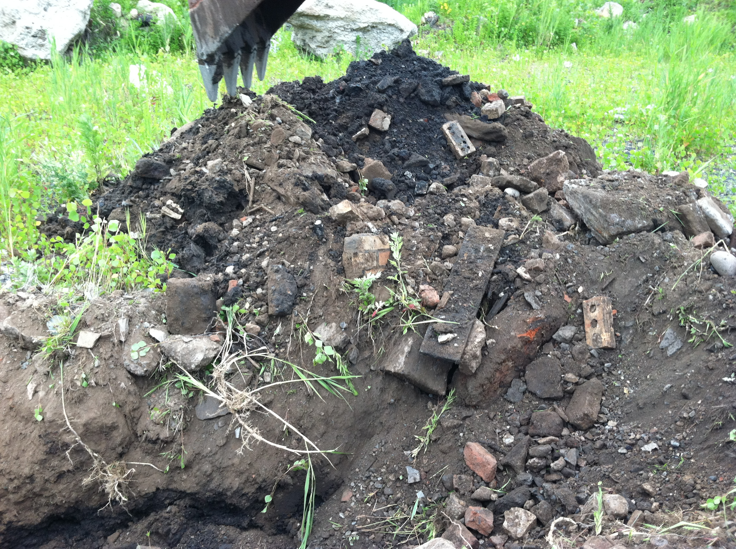

Slide 16
Documenting Soil Sampling DATA For Court Testimony
Laboratory Containers:
NJDEP Certified Laboratory provides custody sealed containers that utilize appropriate:
Material construction
Tinting
Lid structure
Carrier solvent
Preservatives

Slide 17
  Quality Assurance/Quality Control Analyses
        Field Blanks
        Trip Blanks
        Method Blanks
        Matrix Spikes
        Matrix Spike Duplicates

Slide 18
Sampling Procedures
Protective gear should include disposable gloves per each sample location.
Retrieving Sample from Auger head, scoop/spatula
VOC Sampling – Encores or Methanol Extraction
Non-VOC Homogenization

Slide 19
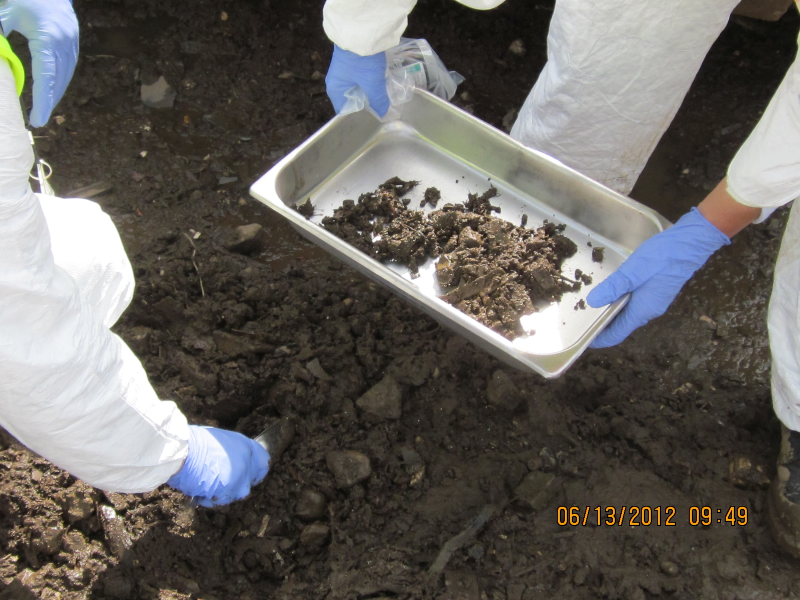

Slide 20
Sampling Procedures (continued)
Dedicated plastic sheeting per sample location.
Documented time of sampling should match in the field notes, laboratory containers and Chain of Custody
Actual person(s) collecting the samples and their actual roles should be defined in the field notes.

Slide 21
Sample Care and Management
Seal lab containers in Nalgene Bags to protect the labels from melting ice.
Wrap each suite of sample containers in tightly packed bubble wrap.
Add the Chain of Custody to the cooler within a sealed bag to ensure ink does not run.
Add copious amounts of ice.
Apply and record cooler Custody Seal # & shipping paper work ID in field notes, secure cooler with tape.

Slide 23

WE DID OUR JOB WELL !!!

Slide 24
Photographic Documentation
Start with a Distance Shot for Sample Location Perspective
Try not to include any information that can be scrutinized
End with a close up shot

Slide 25
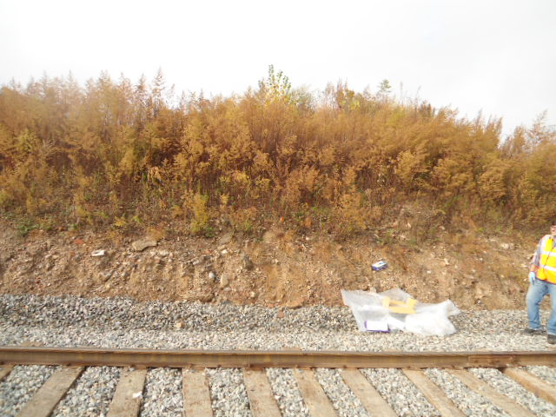

Slide 26
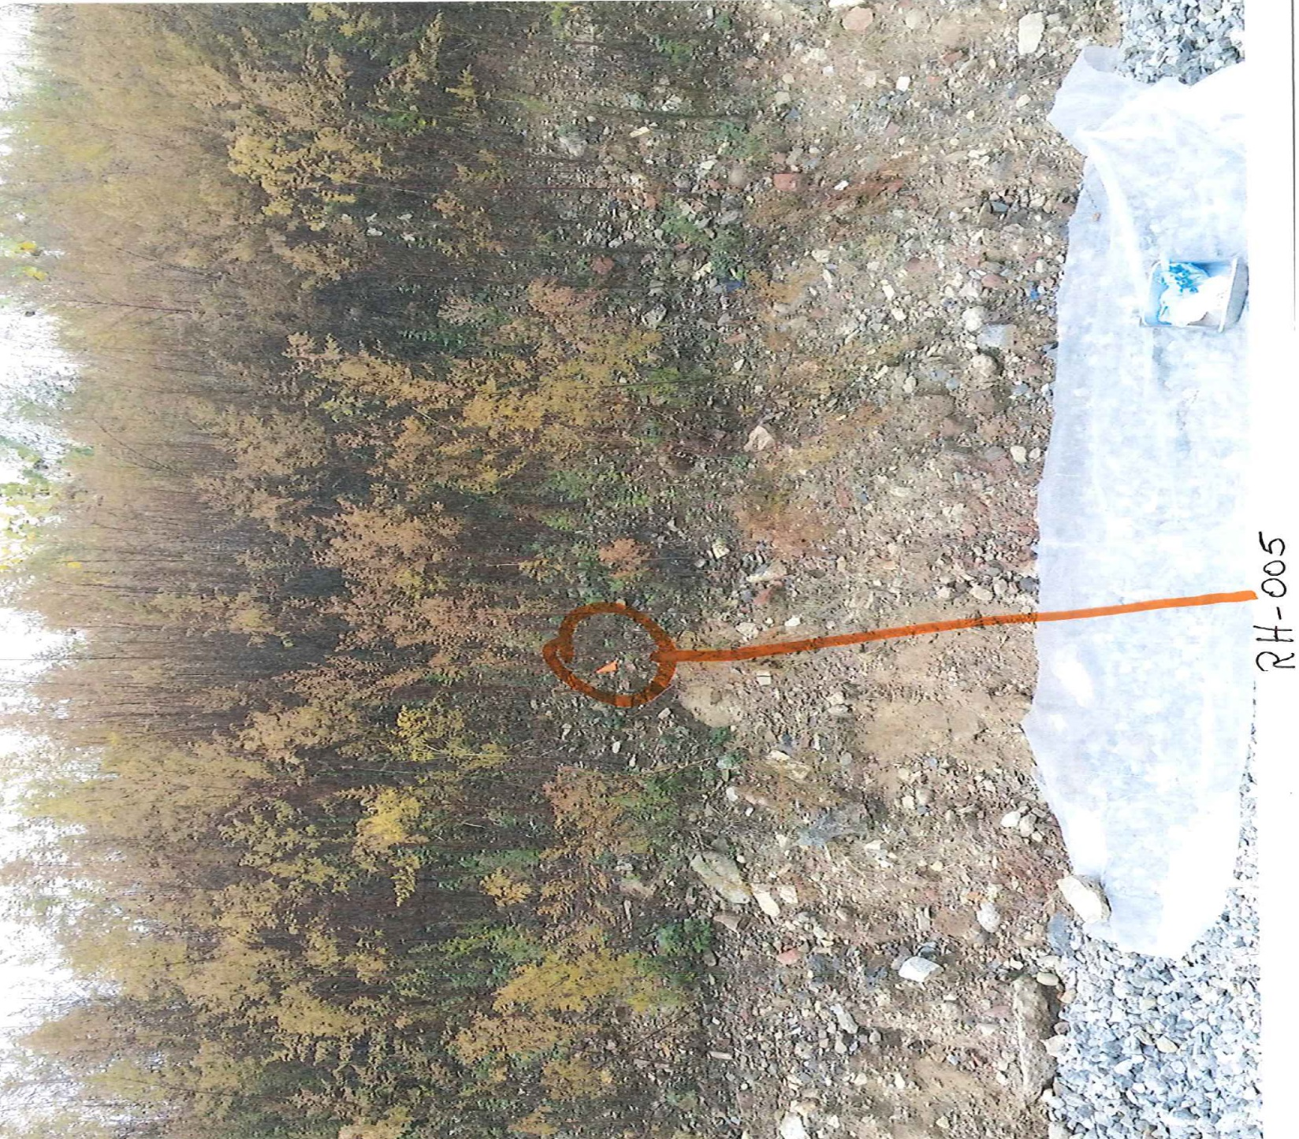

Slide 27
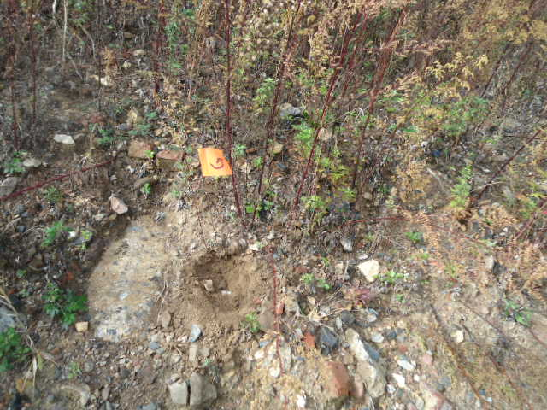

Slide 30
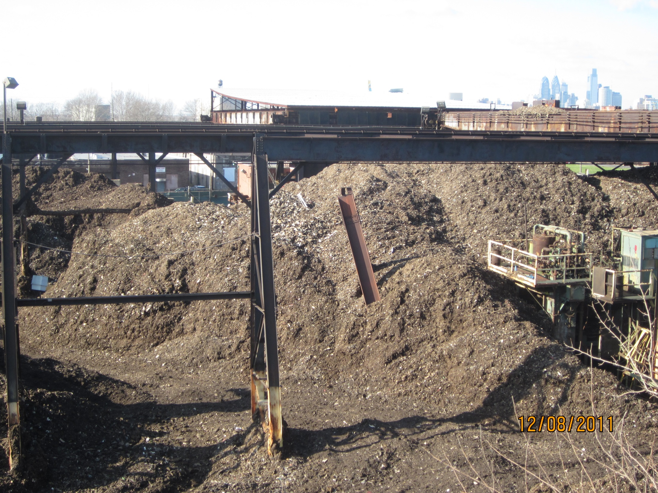

Slide 31
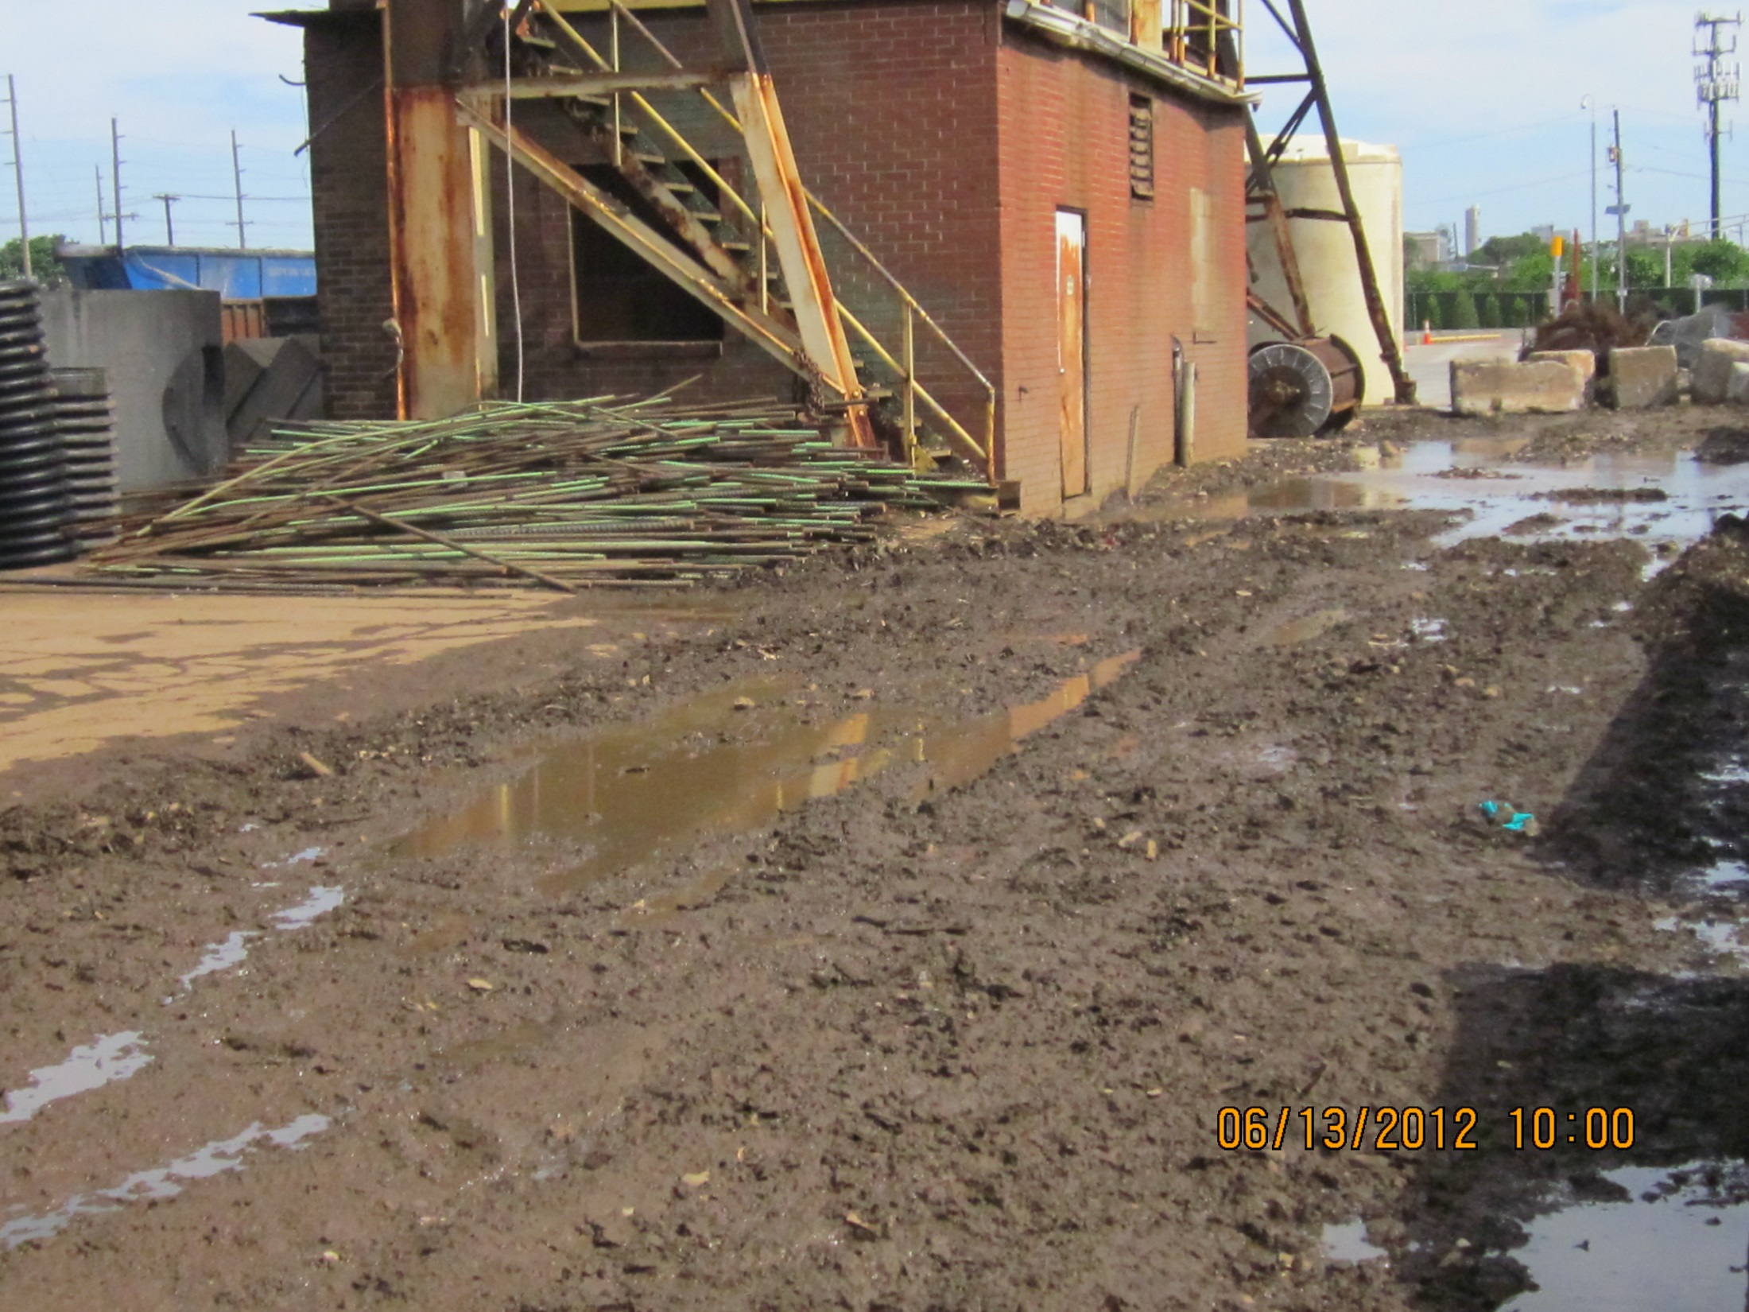

Slide 33
Condensing Significant Data

Slide 34
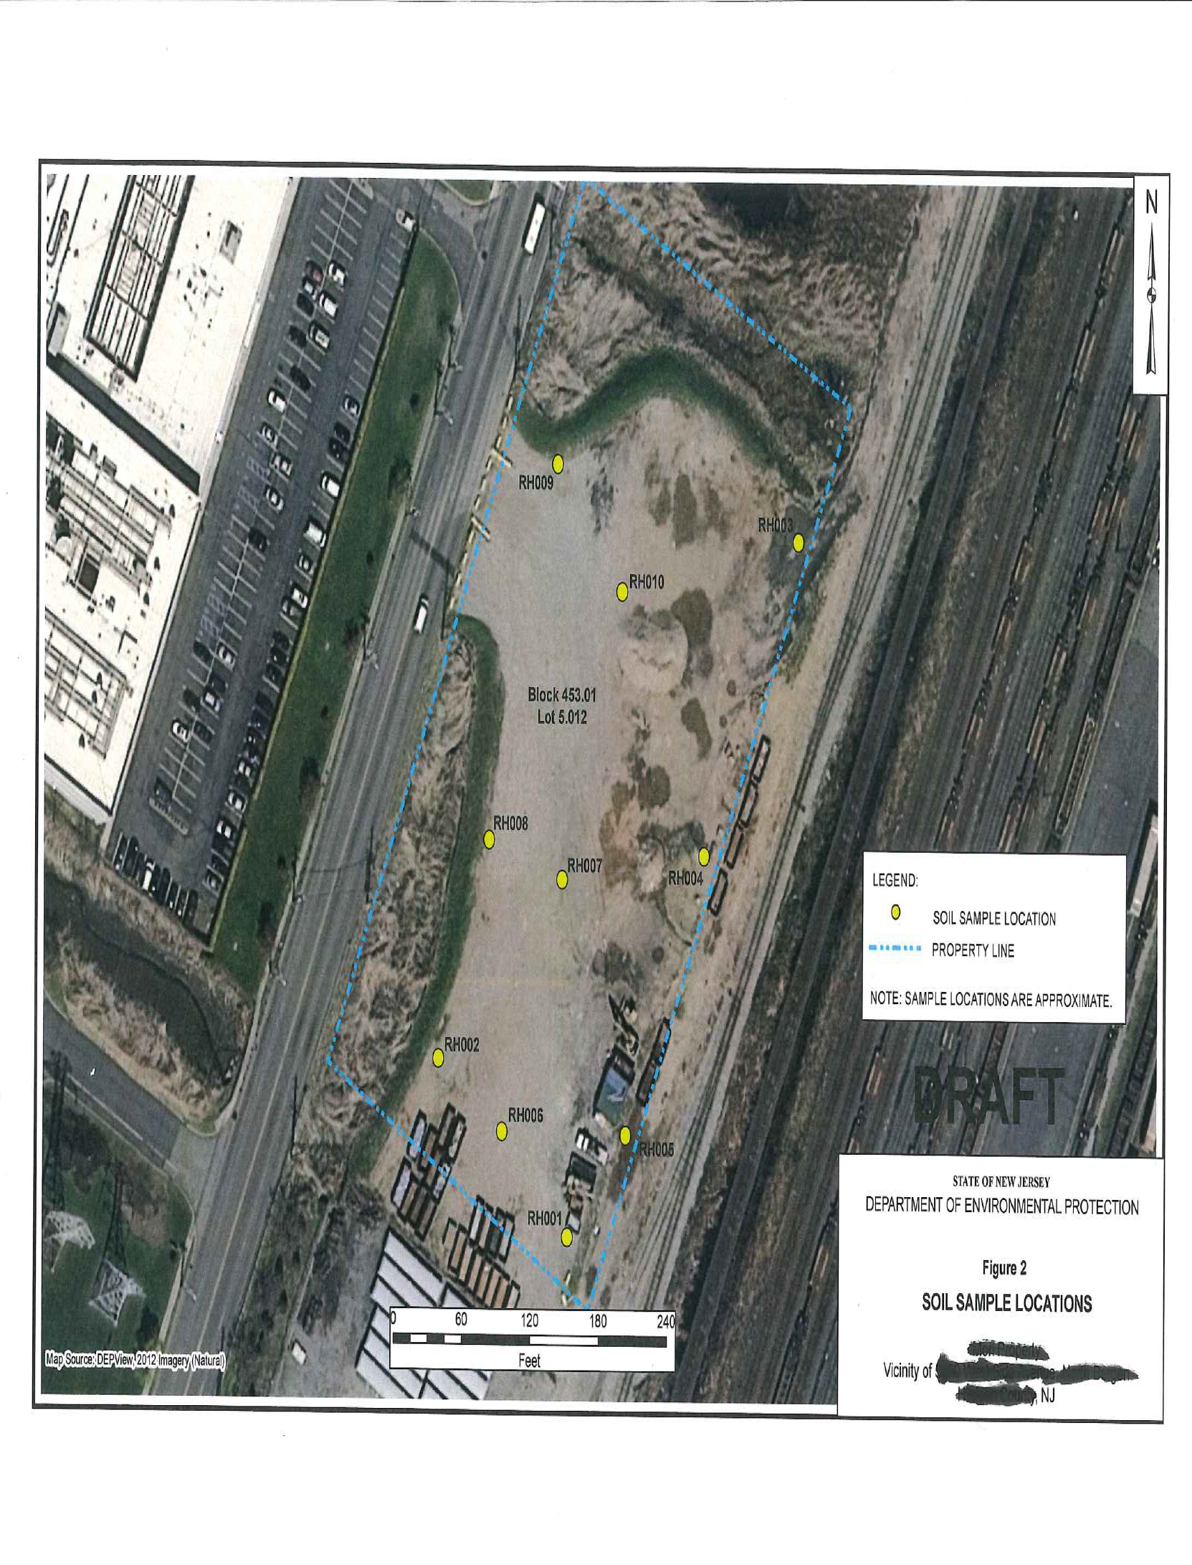
Sample Location Map

Slide 35
Evaluation and Reporting Lab Results
Analytical data package Non-Compliance Summary example statement:
“The responses for each target analyte met the relative standard deviation criterion in the initial calibration with the exception of pyrene”.

Slide 36
Example of NJDEP’s Sampling Report Contents
Regulatory Background
Sampling/Analytical Approach, Quality Assurance Plan & Implementation
Sample and Data Quality Assurance Performance
Data Results and Evaluation

Slide 37
Presenter’s Opinion: Possible Paths to Better Manage Fill?
State-wide Soil Importation Ordinance Template.
Increased flexibility to manage fill with minimal documentation when the use of the fill at its removal point is consistent with the end use of this material provided BMPs employed.
Public education as well as engagement with other government agencies addressing management of daily exposures to contamination from a multitude of potential sources.
Additional Guidance for sites not undergoing remediation.
Special licensing for transporters of recyclable soils.

